Slide 1

Healthcare Analytics Doctor Visits
AICTE Student Id- STU69de8610658df1776190992
Name- Abhishek Pardeshi

Slide 2

PROBLEM STATEMENT
To analyze the Healthcare Analytics for Doctor Visits dataset and identify patterns in doctor visits and illness by examining factors such as income, gender, reduced activity due to illness, health status, and health insurance coverage. The project aims to use data analysis and visualization techniques to understand relationships between these healthcare-related variables based on the provided dataset.

Slide 3
Project Description
This project analyzes the Healthcare Analytics for Doctor Visits dataset to understand patterns in doctor visits, illness, income, gender, reduced activity due to illness, and health insurance coverage. The dataset contains 5,190 records and 13 variables.
The analysis includes counting people based on their number of illnesses, analyzing maximum, minimum, and medium income, comparing reduced activity days between males and females, checking missing values, and examining correlations between numerical variables. It also analyzes the relationship between income and hospital visits using a scatter plot, compares males and females affected by illness, and visualizes different health insurance categories using a pie chart.
The project uses Python, Pandas, Matplotlib, and Seaborn to perform the analysis and create meaningful visualizations based on the given healthcare dataset.

Slide 4

WHO ARE THE END USERS?
Healthcare Analysts – to analyze doctor visits, illness, income, and healthcare patterns.
Hospitals and Clinics – to understand patterns in patient visits and reduced activity due to illness.
Healthcare Researchers – to study relationships between health, income, gender, and insurance coverage.
Healthcare Management Teams – to support data-driven understanding of healthcare utilization.
Students and Data Analysts – for learning and applying healthcare data analysis and visualization techniques.

Slide 5

Technology Used
Technology Used
Python – Data analysis and processing
Pandas – Dataset handling and analysis
NumPy – Numerical operations
Matplotlib – Data visualization
Seaborn – Heat maps and statistical visualizations
Google Colab – Development and execution environment

Slide 6
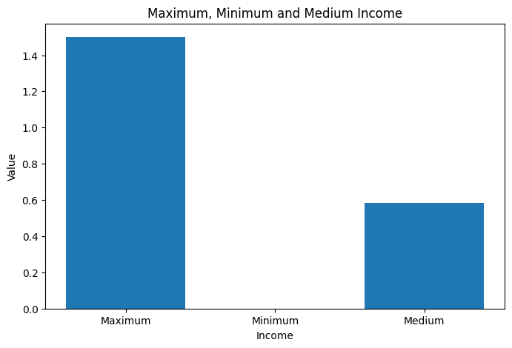
RESULTS
Demo Link

Slide 7
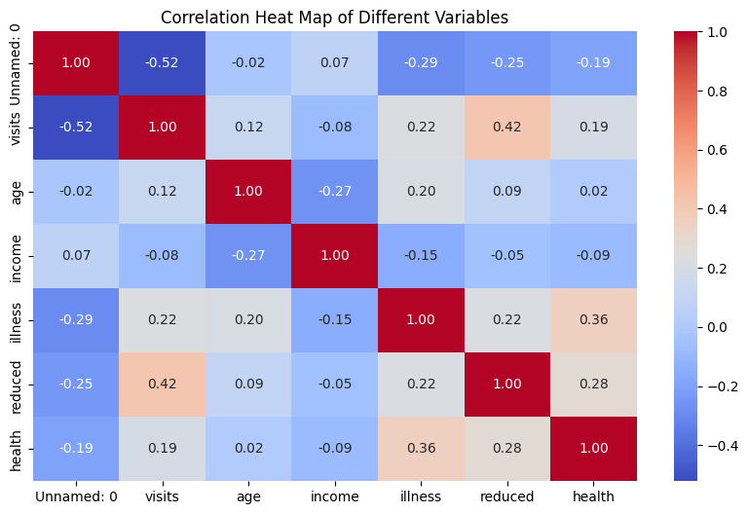
RESULTS
Demo Link

Slide 8
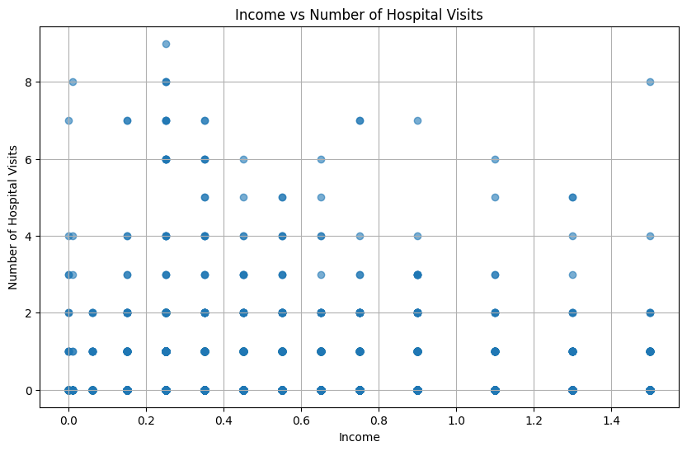
RESULTS
Demo Link

Slide 9
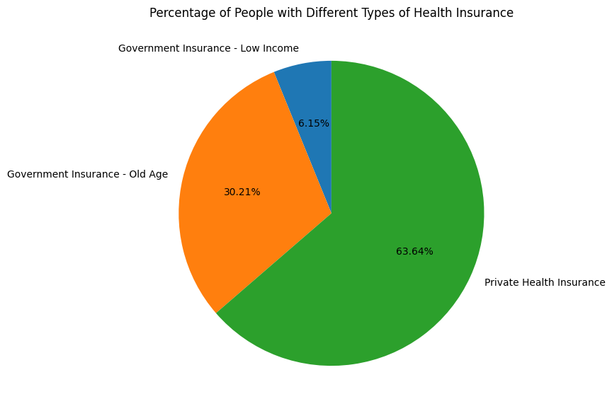
RESULTS
[Add screen shots of your code ]
Demo Link

Slide 10
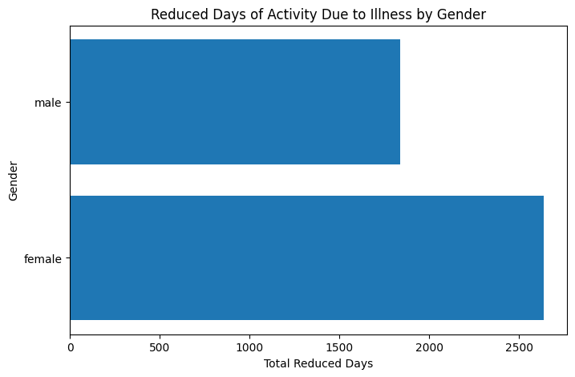
RESULTS
[Add screen shots of your code ]
Demo Link

Slide 11
Github link
[Add screen shots of your code ]
Demo Link

Slide 12
Thank you
.
.

